Slide 1
A Data Validation Oracle
A project on prompt 2, made at Yale-NUS hack4climate

Slide 2
What We Accomplished
Predict energy generated (Linear Regression)
Scraped additional data
Used LSTM for tampering detection
Notes:
Learn(correct values and their effect on the actual generation of electricity) -> use it to predict anomalies

Slide 3
Steps we took
Factors affecting Solar Panel performance
Filter out irrelevant data
Collect external data
Predict average DC Output and average Power Output
Use predicted values for anomaly detection

Slide 4
How we got the external data
Given Data:
Average radiance in Wm^2
Ambient temperature in Celsius
Scraped data:
Humidity percentage
Wind speed

Slide 5
And now...
A graphical overview of our results

Slide 6
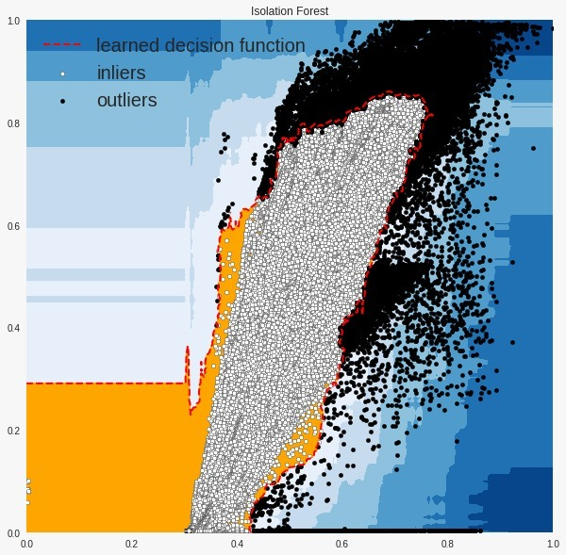
Graphs produced for outlier detection
Isolation Forest - provides an anomaly score looking at how isolated the point is in the structure

Slide 7
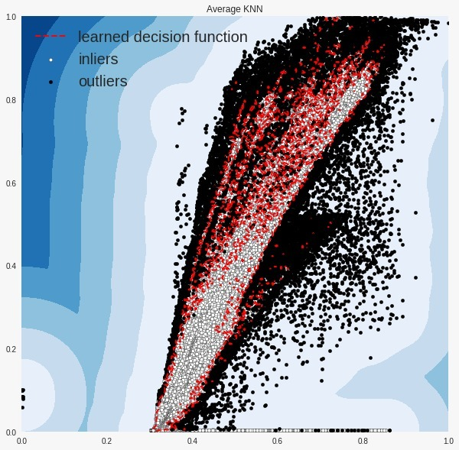
Graphs produced for outlier detection
K Nearest Neighbors - For any data point, the distance to its kth nearest neighbor could be viewed as the outlying score

Slide 8
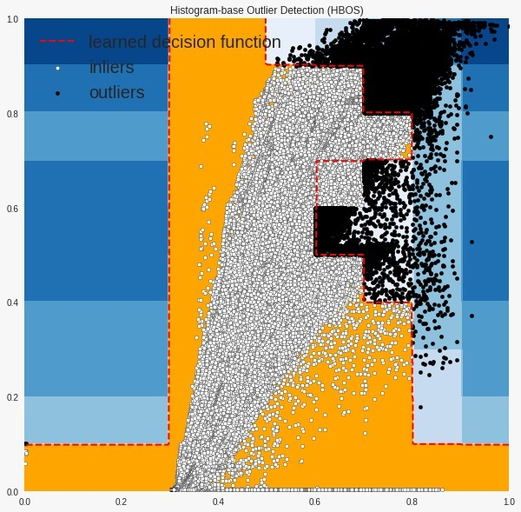
Graphs produced for outlier detection
Histogram Based Outlier Detection - It is an efficient unsupervised method which assumes the feature independence and calculates the outlier score by building histograms

Slide 9
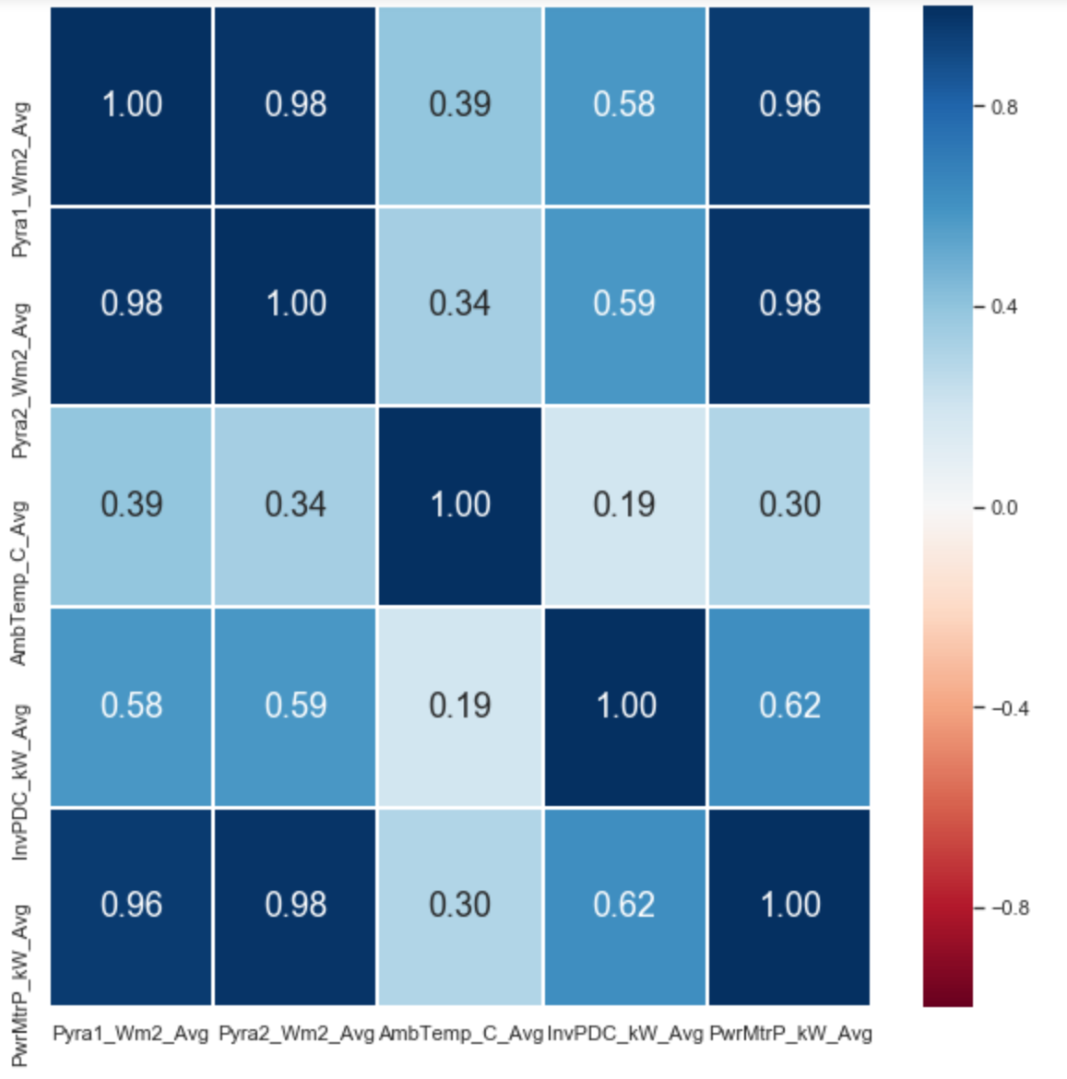
Correlations
Pyra1_Wm2_Avg
Pyra2_Wm2_Avg
AmbTemp_C_Avg

Slide 10
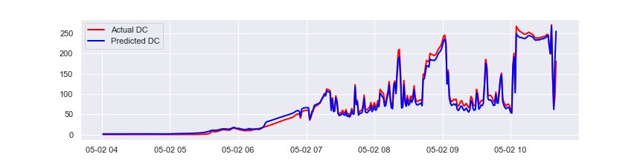
Prediction - Inverter DC input power
Explained Variance (Test Set) - 0.936

Slide 11
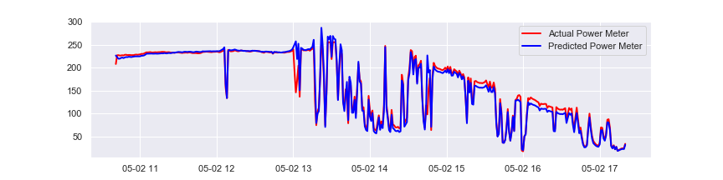
Prediction - Solar AC by Grid Tied meter
Explained Variance (Test Set) - 0.938
These predictions are used to reach a mutual consensus about what is an anomaly

Slide 12
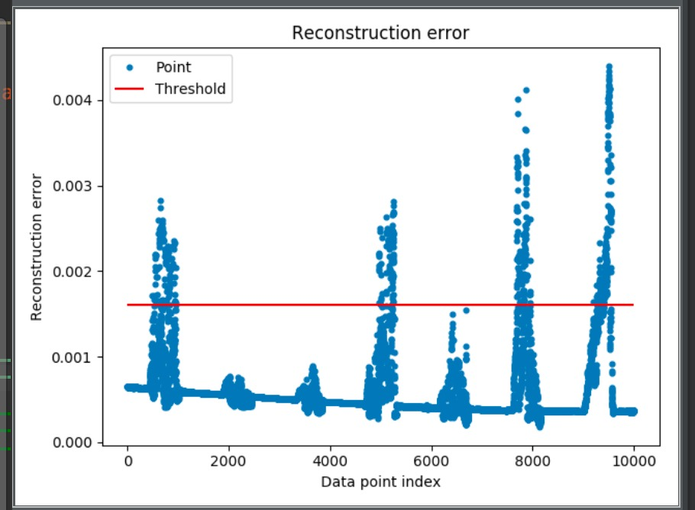
Anomaly Detection
Recall - 0.52

Slide 13
Future Improvements
LSTM for prediction
Additional Data
Time since installation
Time since maintenance

Slide 14




Tech stack
Scikit-learn
Pandas
Requests
Selenium

